Slide 1

Elevar Therapeutics
Elevating Treatment Outcomes For Patients
NON-CONFIDENTIAL
© 2026 Elevar Therapeutics, Inc. All Rights Reserved.

Slide 2
Disclaimer
This presentation has been prepared for informational purposes only. No money or other consideration is being solicited, and if sent in response, will not be accepted. This presentation shall not constitute an offer to sell, or the solicitation of an offer to buy, any securities, nor shall there be any sale of these securities in any state or jurisdiction in which such offer, solicitation or sale would be unlawful prior to registration or qualification under the securities laws of any such state or jurisdiction. The Company is not under any obligation to make an offering. It may choose to make an offering to some, but not all, of the people who indicate an interest in investing. The information included in any registration statement will be more complete than the information the Company is providing now and could differ in important ways.
This presentation contains forward-looking statements about Elevar Therapeutics Inc. (“Elevar Therapeutics” or the “Company”). Forward-looking statements are based on our management’s beliefs and assumptions and on information currently available to our management, including those described in the forward-looking statements.
Such statements are subject to known and unknown risks, uncertainties, and other factors that may cause our or our industry’s actual results, levels of activity, performance, or achievements to be materially different from those anticipated by such statements. In some cases, you can identify forward-looking statements by terminology such as “may,” “will,” “should,” “expects,” “plans,” “anticipates,” “believes,” “estimates,” “predicts,” “potential,” “intends,” or “continue,” or the negative of these terms or other comparable terminology. Forward-looking statements contained in this presentation include, but are not limited to, (i) statements regarding the timing of anticipated clinical trials for our product candidates and our research and development programs; (ii) the timing of receipt of clinical data for our product candidates; (iii) our expectations regarding the potential safety, efficacy, or clinical utility of our product candidates; (iv) the size of patient populations targeted by our product candidates and market adoption of our product candidates by physicians and patients; and (v) the timing or likelihood of regulatory filings and approvals.
Except as required by law, we assume no obligation to update these forward-looking statements publicly, or to update the reasons why actual results could differ materially from those anticipated in the forward-looking statements, even if new information becomes available in the future.
The market data and certain other statistical information used throughout this presentation are based on independent industry publications, governmental publications, reports by market research firms or other independent sources. Some data are also based on our good faith estimates. Although we believe these third-party sources are reliable, we have not independently verified the information attributed to these third-party sources and cannot guarantee its accuracy and completeness. Similarly, our estimates have not been verified by any independent source.
By attending or receiving this presentation and viewing any related videos, you acknowledge that you will be solely responsible for your own assessment of the market and our market position and that you will conduct your own analysis and be solely responsible for forming your own view of the potential future performance of our business.

Slide 3
Company Overview

Slide 4
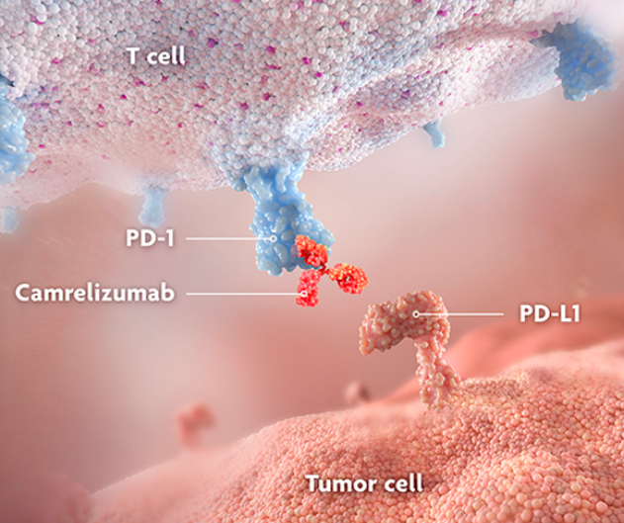
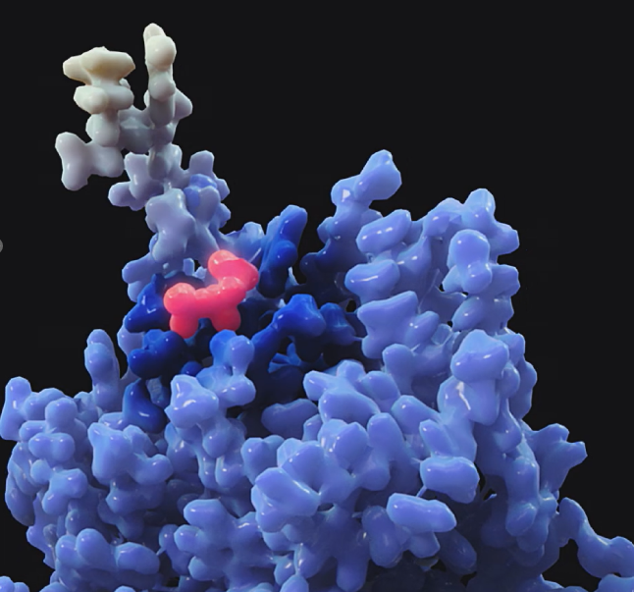

Elevar Therapeutics: delivering late-stage oncology programs with best-in-class potential
RIVOCERANIB + CAMRELIZUMAB: 1st Line Systemic Treatment for uHCC
VEGFR-2 inhibitor + anti-PD-1 targeting immune checkpoint inhibitor
mOS of 23.8 months – the longest for any treatment in a global Phase 3 trial in uHCC
BLA/NDA resubmitted in Jan 2026
EMA MAA preparations ongoing
LIRAFUGRATINIB: FGFR2 inhibitor with tumor-agnostic potential
First highly selective FGFR2 inhibitor with minimized off-target toxicity
First-to-market opportunity for solid tumor patients with FGFR2 alterations
NDA submitted for 2L FGFR2 f/r Cholangiocarcinoma in Jan 2026
Breakthrough designation for CCA – accelerated approval opportunity
Ongoing Phase 2 study for solid tumor patients with FGFR2 f/r
Orphan drug designation from the FDA
Lirafugratinib
.
FGFR2
UHCC, unresectable Hepatocellular Carcinoma; CCA, cholangiocarcinoma
References: 1. Rumgay H, et al. J Hepatol 2022;77(6):P1598-1606. 2. Siegel RL, et al. Cancer J Clin 2023;7(1):17-48. 3. Qiu SK, et al. JAMA Netw Open 2024;7(11):e2445525. doi:10.1001. 4. Cerreto M, et al. Curr Oncol 2023;30(10):8774-8792. 5. Llovet JM, et al. Nat Rev Dis Primers. 2021;7(1):7. 6. Qin S, et al. Lancet 2023;402(10408):1133-1146. 7. Vogel A et al. Poster presented at: ASCO Annual Meeting May 31-June 4, 2024; Chicago, IL. J Clin Oncol 2024;42(16)suppl. Abs 4110. 8. Finn RS, et al. NEJM 2020;382(20):1894-1905. 9. Abou-Alfa GK, et al. NEJM Evid 2022;1(8):doi:10.1056/EVIDoa2100070. 10. Yau T, et al. Lancet 2025;405(10492):P1851-1864. 11. Borad MJ, et al. J Clin Oncol 2023;41(suppl 16):4009. 12. Hollebecque A, et al. EORTC-NCI-AACR Symposium 2024;PB046.
4
Q
Notes:
New reference order
1. Rumgay H, et al. J Hepatol 2022;77(6):P1598-1606. 2. Siegel RL, et al. Cancer J Clin 2023;7(1):17-48. 3. Qiu SK, et al. JAMA Netw Open 2024;7(11):e2445525. doi:10.1001. 4. Cerreto M, et al. Curr Oncol 2023;30(10):8774-8792. 5. Llovet JM, et al. Nat Rev Dis Primers. 2021;7(1):7. 6. Qin S, et al. Lancet 2023;402(10408):1133-1146. 7. Vogel A et al. Poster presented at: ASCO Annual Meeting May 31-June 4, 2024; Chicago, IL. J Clin Oncol 2024;42(16)suppl. Abs 4110. 8. Finn RS, et al. NEJM 2020;382(20):1894-1905. 9. Abou-Alfa GK, et al. NEJM Evid 2022;1(8):doi:10.1056/EVIDoa2100070. 10. Yau T, et al. Lancet 2025;405(10492):P1851-1864.
ANNOTATIONS
Section 1
Successful Phase 3 study/CARES-310 study shows a mOS of 22.1 months in 1L uHCC patients: [Qin 2023/PG2/C2/P2/L1-10; PG3/C1/P2/L1-2]
Current combination therapies for uHCC showed mOS of 16.4-19.2 months: [Cheng 2022/PG864/C2/P3/L1-3]
[Abou-Alfa 2022/PG4/C2/P3/L4-6; PG6/FIGURE1A]
Section 2
15,000+ patients:
41,210 estimated patients diagnosed with liver cancer in 2023: [Siegel 2023/PG20/TABLE 1/L15]
37,089 estimated diagnoses of HCC per year of those patients with liver cancer:
Calculation: 37,089=41,210 with liver cancer X 90% of liver cancer is HCC
90% of cases are HCC: [Llovet 2021/PG1/C1/P1/L4-6]
25,962 estimated cases of uHCC per year:
Calculation: 25,962=37,089 with HCC X 70% of HCC is unresectable
70% of HCC cases are unresectable: [Wang 2017/PG2/C2/P3 ALL]
15,577 estimated cases of uHCC receiving 1L+ treatment per year:
Calculation: 15,577=25,962 with unresectable HCC X 60% undergo systemic treatment
50-60% of HCC exposed to systemic therapy: 60%: [Llovet 2021/PG2/C1/P2/L4-6]
Incidence and mortality: [Golabi 2017/PG1/C2/P2/L3-4]

Slide 5
Regulatory & Development Key Milestones
RIVOCERANIB +
CAMRELIZUMAB
uHCC
BLA/NDA resubmitted in Jan 2026
EU filing preparations ongoing
2025
2026
2027 +
LIRAFUGRATINIB
CCA FGFR2 f/r
Pre-NDA Meeting Completed
LIRAFUGRATINIB
CCA FGFR2 f/r
NDA submitted in Jan 2026
Potential U.S. approval 2H 2026
EU filing Q2-Q3 2026
Tumor Agnostic FGFR2 f/r
Site open and FPI by Q1 2026
LIRAFUGRATINIB
Tumor Agnostic FGFR2 f/r
Complete a global phase 2 study with additional patients
US and EU Filing
Source:
Abbreviations. CCA – cholangiocarcinoma, FGFR2 f/r – fibroblast growth factor receptor 2 fusions/rearrangements, uHCC – unresectable hepatocellular carcinoma

Slide 6
Rivoceranib, Camrelizumab & Lirafugratinib Have Been Studied in More Than 6,000 Patients Worldwide for Multiple Oncology Indications^{1,2}
Molecule | Therapeutic Area | Indication | Phase 1b | Phase 2 | Phase 3 | NDA Filed | Approved
Rivoceranib + Camrelizumab | Oncology | Unresectable Hepatocellular Carcinoma (uHCC) 1L (Hengrui Collaboration)*
Lirafugratinib | Oncology | FGFR2-altered cholangiocarcinoma, 2L*
Lirafugratinib | Oncology | Solid tumors with FGFR2 alterations
Elevar Therapeutics and Jiangsu Hengrui Pharma Announce Global Commercialization Licensing Agreement for PD-1 Inhibitor Camrelizumab in Combination with Rivoceranib for uHCC - Elevar Therapeutics
* Orphan Drug Designation (ODD).
All product and company names are trademarks™ or registered® trademarks of their respective holders. Use of them does not imply any affiliation with or endorsement by them.
uHCC=unresectable hepatocellular carcinoma; ACC=adenoid cystic carcinoma; GC=gastric cancer; CRC=colorectal cancer
References: 1. Elevar Therapeutics. Press release. Accessed September 13, 2023. https://elevartherapeutics.com/2023/08/03/elevar-therapeutics-to-host-august-10-virtual-kol-event-on-phase-3-study-of-rivoceranib-in-combination-with-camrelizumab-in-unresectable-hepatocellular-carcinoma-uhcc/ 2. Elevar Therapeutics. Press release. Accessed September 14, 2023. https://elevartherapeutics.com/2023/07/17/elevar-therapeutics-announces-fda-acceptance-
for-filing-of-new-drug-application-for-rivoceranib-in-combination-with-camrelizumab-as-a-first-line-treatment-for-unresectable-hepatocellular-carcinoma/
Notes:
ANNOTATIONS
More than 6,000 patients: [Elevar Therapeutics to Host_Elevar website/PG4/P1/L5-6] [Elevar Therapeutics Announces FDA Acceptance_Elevar website/PG4/P1/L2-3]
Indications: [Elevar Therapeutics to Host_Elevar website/PG3/P4/L4-7; PG4/P1/L1-3] [Elevar Therapeutics Announces FDA Acceptance_Elevar website/PG3/P6ALL]

Slide 7
Near-Term Pipeline Programs
Camrelizumab + Rivoceranib
First line Unresectable Hepatocellular Carcinoma

Slide 8
Camrelizumab and Rivoceranib are Proven Therapies with Commercial Track Record in China
Elevar plans to leverage the commercial success in China to receive approval for & launch Cam-Rivo for 1L uHCC in the US, EU, and beyond
Camrelizumab plus Rivoceranib
Approved in China for 1L Unresectable hepatocellular carcinoma (uHCC) (Jan 2023); preferred regimen alongside Atezo-Bev Combination
Elevar has global rights to rivoceranib (excluding Greater China and Korea)
Elevar has global rights to camrelizumab for HCC with ability to add indications (excluding Greater China and Korea)
Rivoceranib
    Approved in China (Apatinib®, Hengrui Pharma) for:
      Gastric cancer 1L monotherapy (2014)
      Advanced hepatocellular carcinoma (HCC) 2L monotherapy (2020)
Camrelizumab
    Approved in China (AiRuiKa®, Hengrui Pharma) for eight indications (NSCLC 1L, HCC 2L, esophageal SCC 2L etc.)
    One of the top-selling anti-PD-1s in China
8
Notes:
China SOC for 1L uHCC
Led by Atezo-Bev (/ Sintilimab + Bev biosimilar), Cam-Rivo,
Durva-Treme is not yet approved.
TKI monotherapies (Donafenib, Lenvatinib, sorafenib) if IO-VEGF is contraindicated
Tislelizumab (PD1) monotherapy

Slide 9
Hepatocellular Carcinoma Systemic Therapy Paradigm¹
UNRESECTABLE HCC
Child-Pugh A or B ECOG PS 0-2
Child-Pugh C ECOG PS 3+
First-Line
Systemic Therapy
Best
Supportive Care
Child-Pugh A
Child-Pugh B*
Sorafenib or Lenvatinib
(multikinase inhibitors)
Atezolizumab plus Bevacizumab^{2,3}
(PD-L1 inhibitor + VEGF inhibitor)
Tremelimumab plus Durvalumab⁴
(PD-L1 inhibitor + CTLA-4 inhibitor)
Ipilimumab plus Nivolumab⁵
(CTLA-4 inhibitor + PD-1 inhibitor)
*Per NCCN Guidelines for 1L uHCC, nivolumab and atezolizumab + bevacizumab are useful in certain circumstances (Child-Pugh Class B ); TRAE, treatment related adverse event; Grade 5 refers to death.
References: 1. Leowattana W, et al. World J Gastroenterol. 2023;29(10):1551-1568. 2. Cheng A-I, et al. J Hepatol. 2022;76(4):862-873. 3. Finn RS, et al. N Engl J Med. 2020;382(20):1894-1905. 4. Abou-Alfa GK, et al. NEJM Evid. 2022;1(8):doi: 10.1056/EVIDoa2100070 5. Yau T, et al. Lancet 2025;405(10492):P1851-1864. 6. Qin S, et al. Lancet. 2023;402(10408):1133-1146. 7. Vogel A et al. Poster presented at: ASCO Annual Meeting; May 31-June 4, 2024; Chicago, IL. J Clin Oncol. 2024;42(16)suppl. Abs 4110.
Notes:
ANNOTATIONS
Slide had solo reference:
New Drug Report (IDP Analytics, October 2023)
Since this reference was unavailable, new references added to slide
ANNOTATION for Figure (top and left side of slide):
Leowattana 2023/PG1559/FIGURE1
Note: Camrelizumab plus rivoceranib is NOT in Figure 1, as this drug combination is not yet approved (included as forward-thinking)
ANNOTATIONS for blue table (Atezo plus beva):
MOA: Cheng 2022/PG863/C1/P3/L1-5
OS: Cheng 2022/PG864/C2/P3/L1-3
PFS: Cheng 2022/PG864/C2/P4ALL
Safety: Finn 2020/PG1901/C2/P1/L17-21
ANNOTATIONS for blue table (Durva plus treme):
MOA: Abou-Alfa 2022/PG2/C1/P4/L4-5
OS: Abou-Alfa 2022/PG4/C2/P3/L4-6; PG6/FIGURE1A; STRIDE defined: Abou-Alfa 2022/PG2/C1/P4/L4-7
PFS: Abou-Alfa 2022/PG6/FIGURE1B; STRIDE defined: Abou-Alfa 2022/PG2/C1/P4/L4-7
Safety: Abou-Alfa 2022/PG9/TABLE3
ANNOTATIONS for blue table (Cam plus rivo):
MOA: Qin 2023/PG2/C2/P5/L1-4
OS: Qin 2023/PG6/C2/P3/L3-9
PFS: Qin 2023/PG6/C2/P1/L5-10
Safety: Qin 2023 supplemental appendix/PG15/TABLES9/L2

Slide 10
Camrelizumab plus Rivoceranib shows best-in-class potential with longest mOS and favorable safety (CARES-310)
OS | PFS | Safety (TRAE Discontinuation Rates) | TRAE Grade 5
23.8 months (95% CI, 20.61-27.2) [HR 0.64 (95% CI, 0.52-0.79)] | 5.6 months (95% CI, 5.5-7.43) [HR 0.54 (95% CI, 0.44-.67)] | 4.4% (both components) | 0.4% (1 of 272)
19.2 months (95% CI,17.0-23.7) P <.001 [HR 0.66 (95% CI, 0.52-0.85)] | 6.9 months (95% CI, 5.7-8.6) P <.001 [HR 0.65 (95% CI, 0.53-0.81)] | 7% (both components) | 1.5% (5 of 336)
16.4 months (95% CI, 14.16-19.58) P =.0035 [HR 0.78 (95% CI, 0.65-0.93)] | 3.8 months Not significantly different [HR 0.90 (95% CI, 0.77-1.05)] | 13.7% | 2.3% (9 of 393)
23.7 months (95% CI, 18.8-29.4) P =.018 [HR 0.79 (95% CI, 0.65-0.96)] | 9.1 months PFS was an exploratory endpoint | 18% | 3.6% (12 of 332)
Camrelizumab plus Rivoceranib^{6.7}
(PD-1 inhibitor + VEGF 1-3 inhibitor)
Atezolizumab plus Bevacizumab^{2,3}
(PD-L1 inhibitor + VEGF inhibitor)
Tremelimumab plus Durvalumab⁴
(PD-L1 inhibitor + CTLA-4 inhibitor)
Ipilimumab plus Nivolumab⁵
(CTLA-4 inhibitor + PD-1 inhibitor)
*Per NCCN Guidelines for 1L uHCC, nivolumab and atezolizumab + bevacizumab are useful in certain circumstances (Child-Pugh Class B ); TRAE, treatment related adverse event; Grade 5 refers to death.
References: 1. Leowattana W, et al. World J Gastroenterol. 2023;29(10):1551-1568. 2. Cheng A-I, et al. J Hepatol. 2022;76(4):862-873. 3. Finn RS, et al. N Engl J Med. 2020;382(20):1894-1905. 4. Abou-Alfa GK, et al. NEJM Evid. 2022;1(8):doi: 10.1056/EVIDoa2100070 5. Yau T, et al. Lancet 2025;405(10492):P1851-1864. 6. Qin S, et al. Lancet. 2023;402(10408):1133-1146. 7. Vogel A et al. Poster presented at: ASCO Annual Meeting; May 31-June 4, 2024; Chicago, IL. J Clin Oncol. 2024;42(16)suppl. Abs 4110.
Notes:
Use generic manufacturing photo. Share stock photos source.

Slide 11
mOS 23.8 Months at Final Study Analysis¹
OS: FINAL ANALYSIS ^{1, 2}
100
23.8 months
75
76.6%
Cam + Rivo
n = 272
Sorafenib
n = 271
60.9%
No. of events (%) | 159 (59) | 192 (71)
Median OS, months (95% CI) | 23.8 (20.6-27.2) | 15.2 (13.2-18.5)
OS (%)
50
49.0%
15.2 months
37.7%
25
32.6%
24.8%
Stratified HR, 0.64 (95% CI, 0.52-0.79)ª, p < 0.0001^{b}
0
0
2
4
6
8
10
12
14
16
18
20
22
24
26
28
30
32
34
36
38
40
42
44
46
Time (months)
No. at risk
Camrelizumab + rivoceranib | 272 | 265 | 250 | 231 | 224 | 215 | 204 | 193 | 172 | 156 | 147 | 136 | 124 | 111 | 94 | 73 | 49 | 35 | 24 | 19 | 15 | 3 | 1 | 0
Sorafenib | 271 | 268 | 232 | 214 | 198 | 171 | 158 | 138 | 126 | 118 | 108 | 94 | 83 | 78 | 70 | 55 | 43 | 34 | 21 | 14 | 9 | 2 | 0
The stratification factors were the randomization strata.
There was very early and durable separation in the KM curves for Cam/Rivo vs Sorafenib.
CI=confidence interval; HR=hazard ratio; ITT=intent to treat; OS=overall survival.
ªStratified Cox proportional hazards model. ^{b}One-sided based on the stratified log-rank test.
1. Vogel A et al. Poster presented at: ASCO Annual Meeting; May 31-June 4, 2024; Chicago, IL. J Clin Oncol. 2024;42(16)suppl. Abs 4110.
2. Qin S, et al. Lancet. 2023;402(10408):1133-1146.

Slide 12
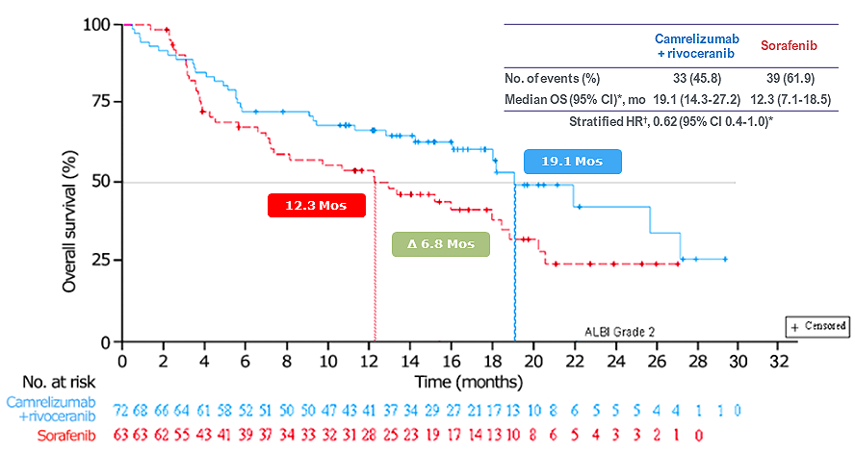
OS survival benefit observed across key subgroups, including baseline ALBI grade, etiology, EHS, and MVI
OS SUBGROUP ANALYSIS¹
ALBI Grade 2²
ng/mL
ng/mL
  HR 0.62 (0.47-0.83) for ALBI grade 1
  HR 0.62 (0.4-1.0) for ALBI grade 2
*Cox proportional hazards model.
References: 1. Qin S, Chan SL, Gu S, et al. Lancet. 2023;402(10408):1133-1146. 2. Vogel A, et al. J Clin Oncol. 2024;42(3 suppl):abstract 509.
12

Slide 13
Cam-Rivo was well tolerated, with most common TRAEs being manageable
Cam + Rivo (n=272)
Sorafenib (n=269)
 | Cam + Rivo (n=272) |  | Sorafenib (n=269)
 | ANY GRADE | GRADE ≥3 | ANY GRADE | GRADE ≥3
Hypertension | 189 (69.5) | 104 (38.2) | 117 (43.5) | 40 (14.9)
AST increased | 149 (54.8) | 47 (17.3) | 101 (37.5) | 14 (5.2)
Proteinuria | 135 (49.6) | 16 (5.9) | 73 (27.1) | 5 (1.9)
ALT increased | 129 (47.4) | 38 (14.0) | 81 (30.1) | 8 (3.0)
Platelet count decreased | 126 (46.3) | 32 (11.8) | 90 (33.5) | 4 (1.5)
Blood bilirubin increased | 117 (43.0) | 24 (8.8) | 75 (27.9) | 4 (1.5)
PPE syndrome | 102 (37.5) | 33 (12.1) | 164 (61.0) | 42 (15.6)
Diarrhea | 84 (30.9) | 6 (2.2) | 106 (39.4) | 14 (5.2)
RCCEP | 82 (30.1) | 8 (2.9) | 0 | 0
Neutrophil count decreased | 75 (27.6) | 16 (5.9) | 28 (10.4) | 3 (1.1)
White blood cell count decreased | 74 (27.2) | 7 (2.6) | 38 (14.1) | 4 (1.5)
GGT increased | 65 (23.9) | 26 (9.6) | 49 (18.2) | 19 (7.1)
Hypothyroidism | 58 (21.3) | 0 | 17 (6.3) | 0
Fatigue | 56 (20.6) | 8 (2.9) | 21 (7.8) | 1 (0.4)
TRAEs from CARES-310 study
Safety data aligned with the interim OS analysis,¹ with no new signals noted. TRAE led to discontinuation of camrelizumab in 17.6%, rivoceranib in 16.9% and 4.4% in the combo arm.
Discontinuation rate of both agents was low, at 4.4%. Sorafenib was discontinued in 4.8% due to TRAE
Vogel A et al. Poster presented at: ASCO Annual Meeting; May 31-June 4, 2024; Chicago, IL. J Clin Oncol. 2024;42(16)suppl. Abs 4110Data are n (%). *TRAE=treatment adverse event, s of any grade occurring in ≥20% or of grade≥3 occurring in ≥5% of patients in either group are listed. AST. Aspartate aminotransferase; ALT=alanine aminotransferase; GGT, Gamma-glutamyltransferase; PPE, palmar-plantar erythrodysaesthesia; RCCEP, reactive cutaneous capillary endothelial proliferation

Slide 14
Summary – Cam-Rivo has the potential to become a differentiated option in 1L treatment of uHCC
Longest mOS in a global Ph3 study to date; survival benefit consistently observed even in high-risk subgroups
Well tolerated with manageable toxicities and low discontinuation rate
Commercial success in China by Hengrui Pharma (Elevar’s partner) underscores Cam-Rivo’s potential to reshape the 1L uHCC treatment landscape
FDA CRLs were limited to CMC observations; Elevar and Hengrui have resubmitted the NDA/BLA in Jan 2026
EMA MAA preparations are underway; Cam-Rivo’s inclusion in ESMO treatment guidelines reflects strong KOL anticipation ahead of market entry

Slide 15
Near-Term Pipeline Programs
Lirafugratinib
Second Line Intrahepatic Cholangiocarcinoma with
FGFR2 Fusion and Rearrangement
Second Line Solid Tumors with
FGFR2 Fusion and Rearrangement

Slide 16



Lirafugratinib: potential best-in-class efficacy in FGFR2 f/r CCA, under development for tumor-agnostic expansion
Preliminary data across multiple indications demonstrate
improvement in efficacy and safety with low
discontinuation rate, compared to standard of care
Lirafugratinib
NDA submitted to the FDA for 2L FGFR2 f/r CCA;
further clinical development ongoing in non-CCA solid tumors, based on latest clinical data and encouraging FDA feedback
FGFR2
Lirafugratinib has potential for global first-to-market opportunity for tumor-agnostic treatment of FGFR2 f/r solid tumors

Slide 17
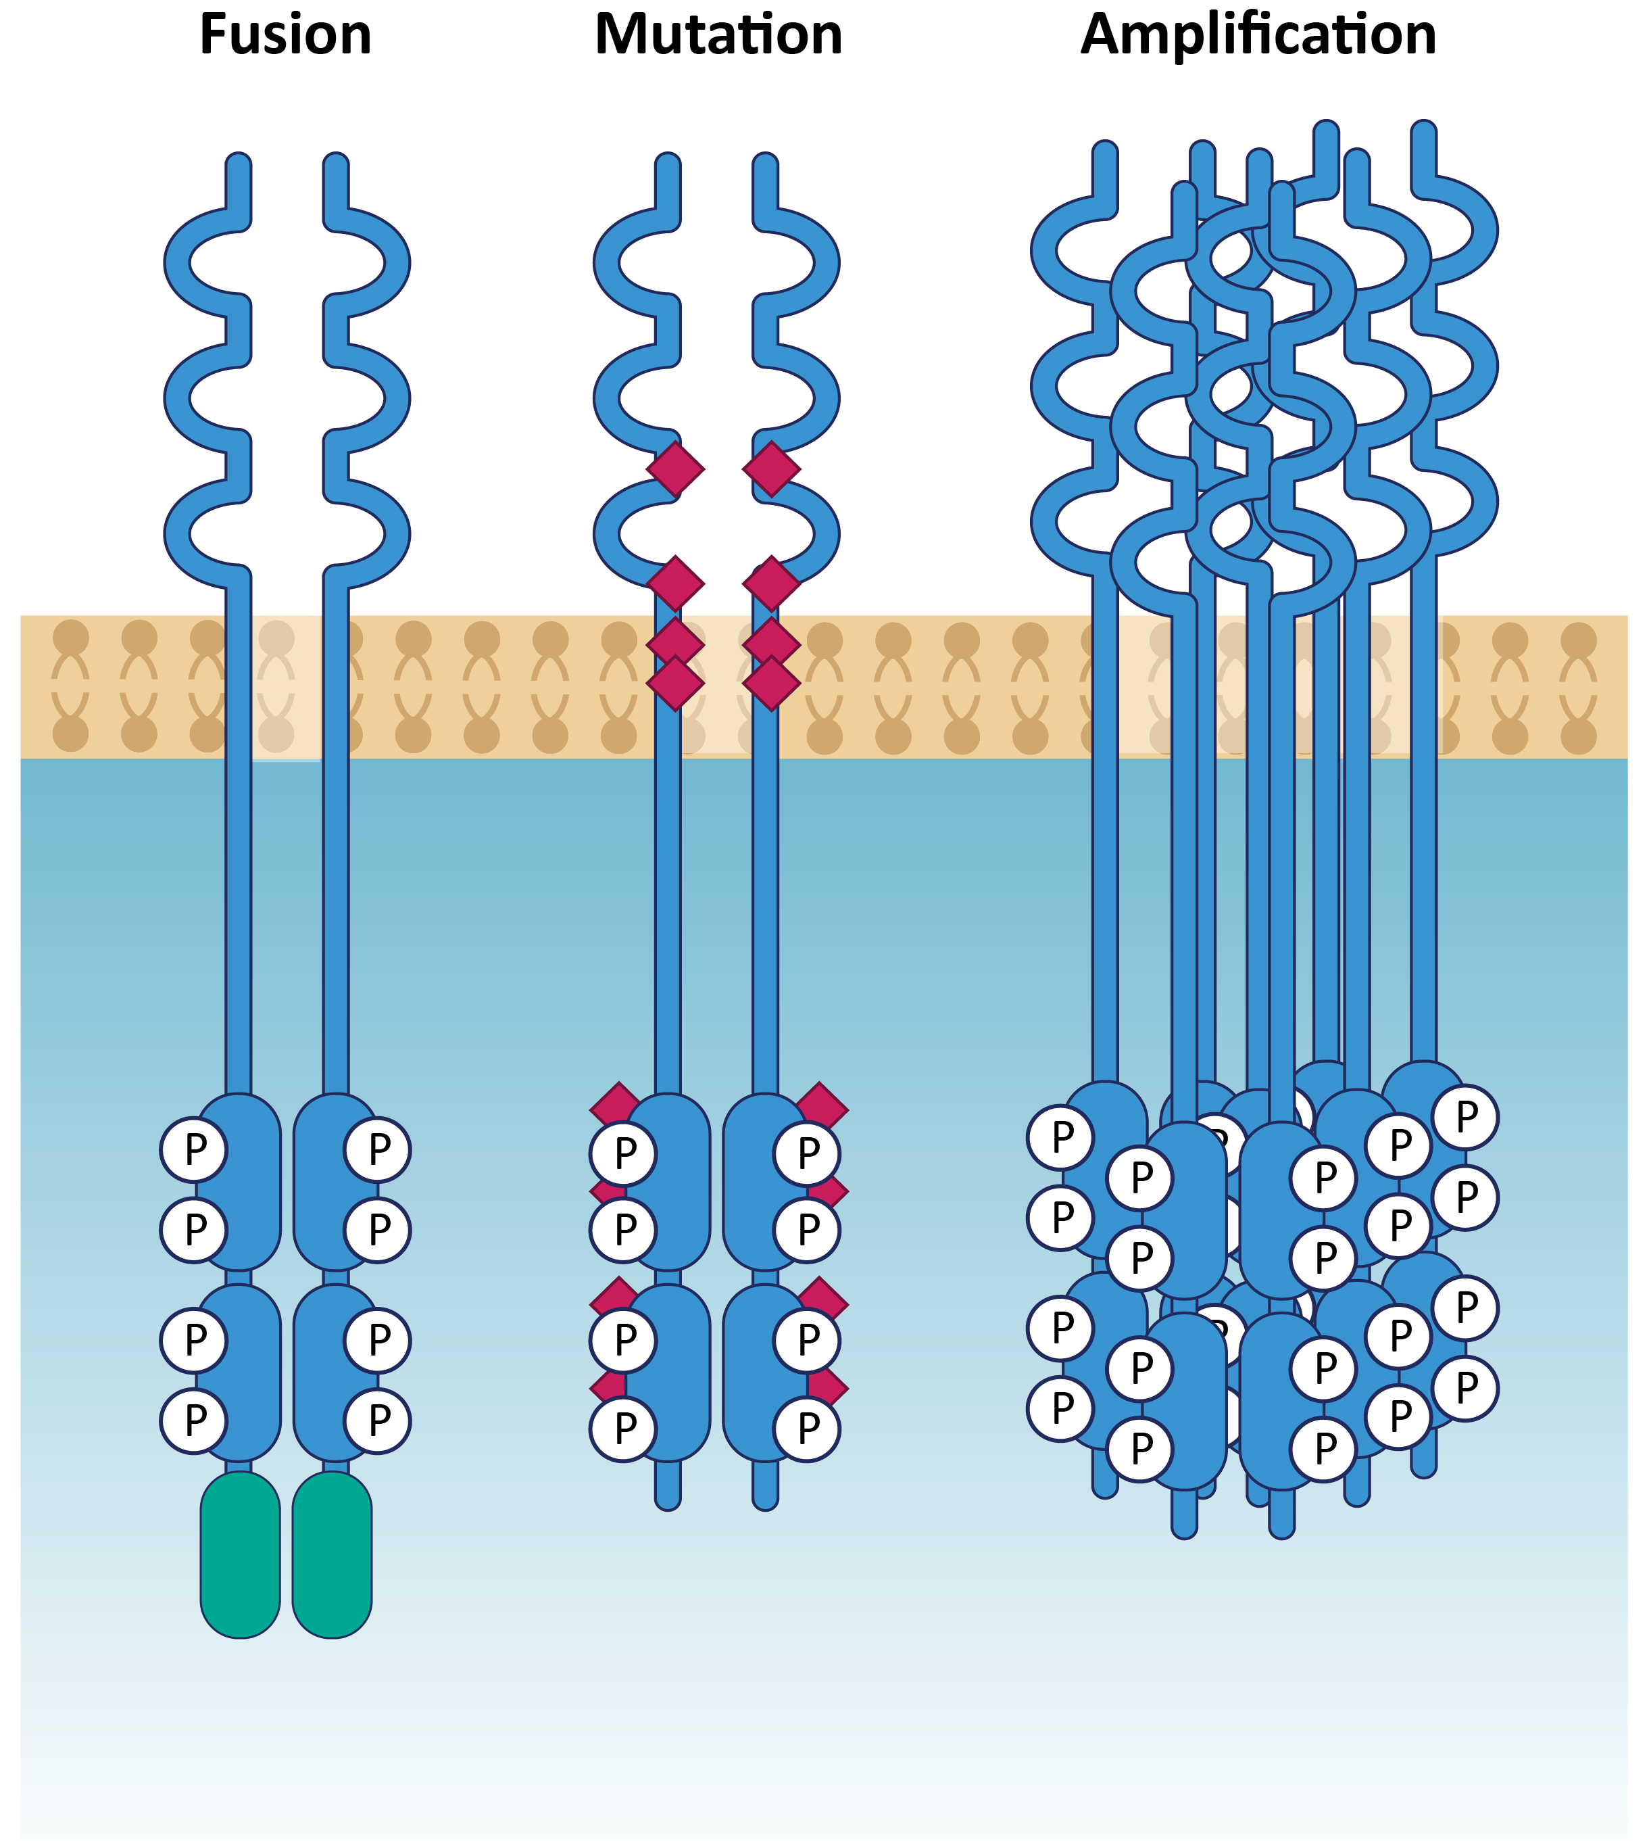
FGFR2 — Validated Target Present in Several Tumor Types
Three classes of driver
alterations in FGFR2
FGFR2 alterations are observed across multiple tumor types²
FGFR2 Annual Cases
(US, comprehensive)
Total FGFR2 alterations¹:
~11-35K patients
Breast
CUP
Endometrial
Cholangio
Stomach
Skin Melanoma
Lung
Bladder
Pancreatic
~4.5K-14K
~6.5K-21K
Ovarian
Annual US Patient Count¹
Fusions³
Amplifications
Mutations
Sources: Image adapted from Babina IS, Turner NC. Nat Rev Cancer 2017;17: 318-332; Internal analysis based on third party industry data
1. All patient #’s refer to total annual number of US patients with late-line cancers vs. comprehensive annual incidence that may be amenable to treatment with our programs including additional FGFR gene fusions and rearrangements resulting
from truncation of the protein at exon 18; 2. Cholangio, cholangiocarcinoma (CCA); CUP, carcinoma unknown primary; 3. FGFR2 fusion estimates include del18 truncations;

Slide 18
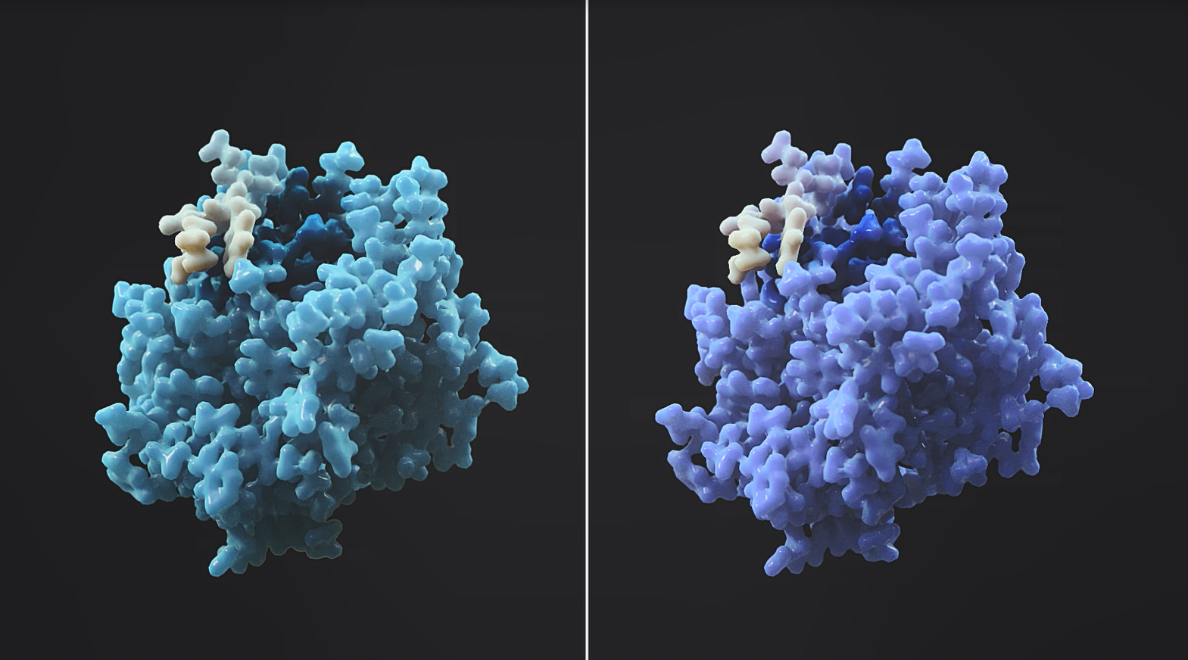
Currently approved FGFR inhibitors are associated with off-target toxicity and limited efficacy
FGFR1-4 static structures look the same
No FGFR2-targeted therapy available
Efficacy limited by off-target tox
CCA
Pan-FGFRi's lead to high rates of off-target toxicity, esp. for FGFR1,4
36-42%
ORR in currently approved tx¹
(in fusion+ CCA, FGFRi-naïve pt)
FGFR1
FGFR2
FDA Approved Compound¹ | % of Patients with Hyperphosphatemia | % of Patients with Diarrhea
Pemigatinib | 93% | 39%
Futibatinib | 88% | 33%
Erdafitinib | 71% | 59%
Non-CCA Solid Tumors
0-15%
ORR in approved late-line tx²
(based on NCCN guidelines)
Chemo and other late line therapies also have high rates of AEs and dose modifications
mPFS 1-5mo in
non-CCA solid tumors
Pan-FGFR inhibitors are often limited by off-target toxicities that prevent dosing at maximum efficacy;
selective inhibition of FGFR2 offers the potential to achieve optimal efficacy with an improved safety profile
Sources.: 1. Pemigatinib – prescribing information; futibatinib – prescribing Information; erdafitinib – prescribing information; (note: AEs are reflective of respective label indications); 2. Reflects reported ORRs in key randomized studies evaluating NCCN recommended regimens for recurrent/metastatic patients (second/third line or later) for the following tumor types: HR+ breast cancer, gastric cancer, pancreatic cancer, NSCLC, ovarian cancer, and head and neck

Slide 19
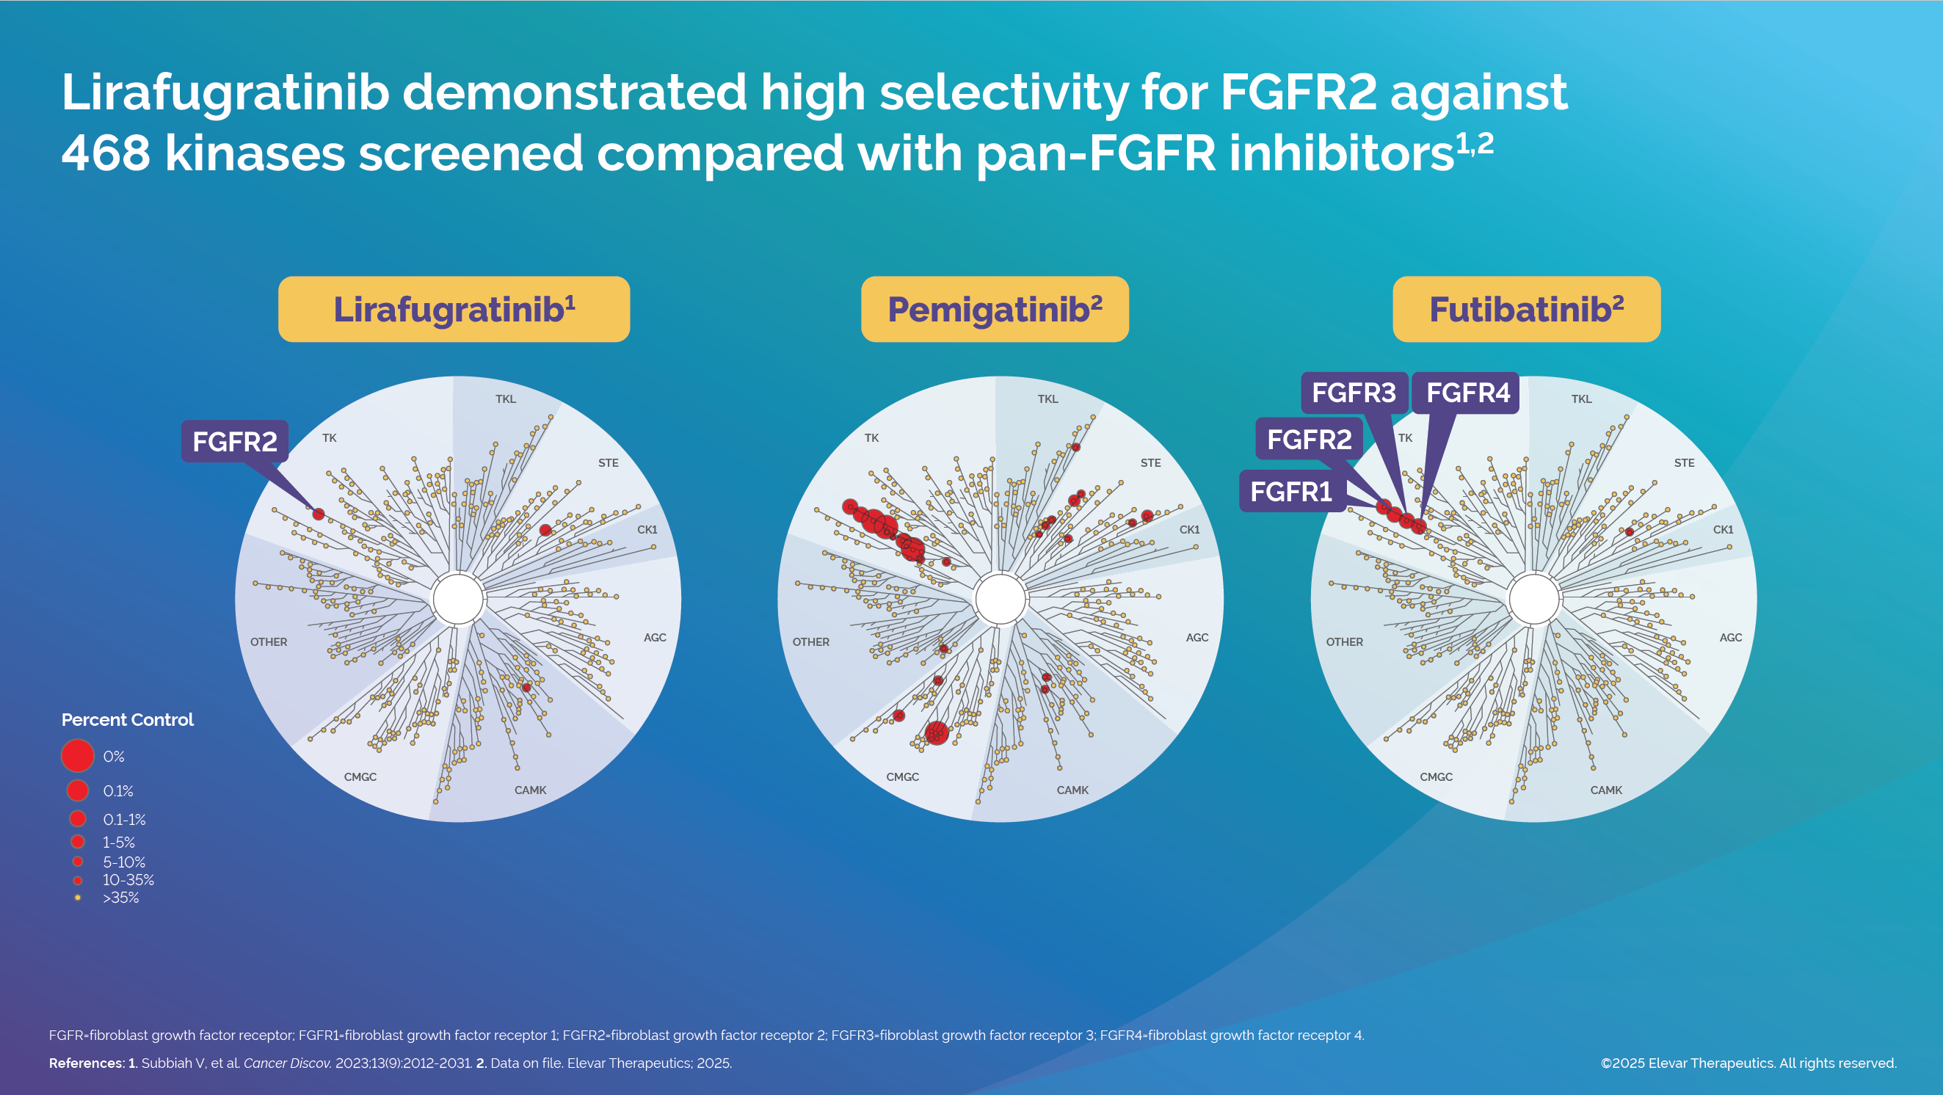

Slide 20
Pivotal data for 2L CCA (FGFR f/r) showed meaningful improvement to efficacy and safety compared to FDA-approved pan-FGFR inhibitors
ORR | DCR | mOS (months) | mPFS (months) | mDOR (months) | Gr≥3 TEAE | Discontinuation Rate
46.5% | 96.5% | 22.8 | 11.3 | 11.8 | 62.9% Most common: PPES (20%), stomatitis (12.2%), anaemia (8.3%) | 4.9%
36% | 82% | 17.5 | 7.0 | 9.1 | 68.7% Most common: hypophosphatemia (14.3%), stomatitis (6.8%), arthralgia (6.1%) | 9%
42% | 83% | 21.7 | 9.0 | 9.7 | 77% Most common: hyperphosphatemia (30%), increased AST (10%), fatigue (8%), stomatitis (6%), hyponatremia (11%) | 4.9%
Lirafugratinib¹
(irreversible FGFR2i)
Pemigatinib²
(reversible FGFR1-3i)
Futibatinib³
(irreversible FGFR1-4i)
Lirafugratinib is the first selective FGFR2 inhibitor designed to improve antitumor activity while minimizing FGFR1/3/4 associated toxicities
Safety data (n=385) showed tolerable safety profile; AEs were manageable and mostly FGFR2-associated toxicities
NDA submitted in January 2026; eligible for accelerated approval by the FDA
Pivotal Phase 2 study was conducted globally (US, EU4, Netherlands, Sweden, UK, South Korea, Singapore, Australia, Hong Kong)
CCA-cholangiocarcinoma; DCR-disease control rate; FGFR f/r-fibroblast growth factor receptor fusion/rearrangement; mDOR-median duration of response; mOS-median overall survival; mPFS-median progression
free survival; ORR-objective response rate; PPES-palmar-plantar erythrodysesthesia; TEAE-treatment emergent adverse event;
References:¹Data on file from the ReFocus study; ²Vogel et al. ESMO Open. 2024 Jun;9(6):103488; ³Pemigatinib FDA prescribing information.
Notes:
Use generic manufacturing photo. Share stock photos source.

Slide 21
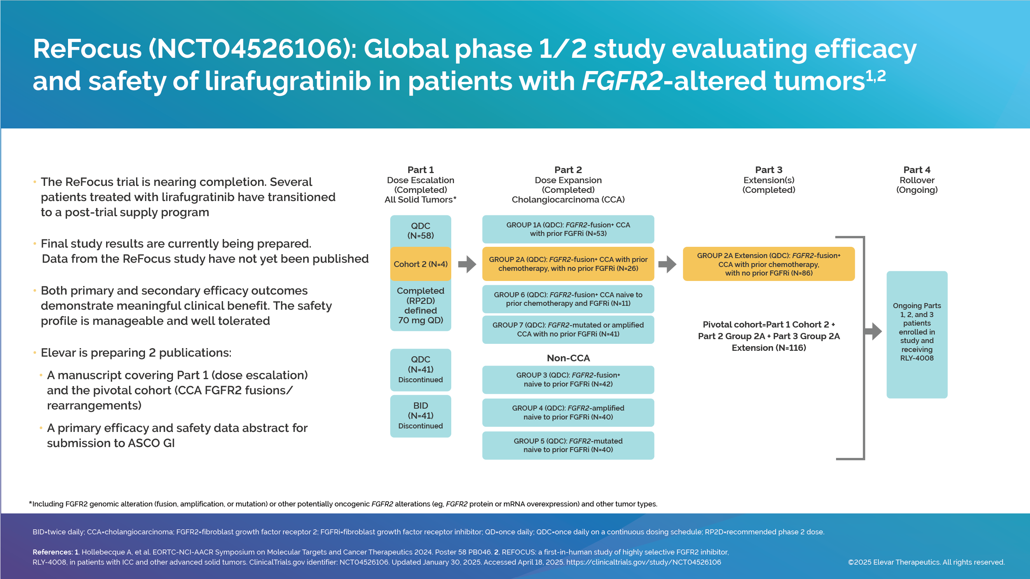
ReFocus study investigated lirafugratinib in 490 solid tumor patients with FGFR2 fusion, amplification, and mutation, with promising initial efficacy and safety
ReFocus study (by previous sponsor Relay) investigated lirafugratinib across wide range of solid tumors
Primary and secondary efficacy outcomes demonstrate meaningful clinical benefit; safety profile is manageable and well tolerated
Several patients treated with lirafugratinib have transitioned to post-trial supply program

Slide 22
Leadership & SAB

Slide 23






Leadership Team
    Dong-Gun Kim
    Chief Executive Officer
    Michael Palucki
    Sr. Vice President, Manufacturing
    Chul Woong Park
    Chief Financial Officer
    Dominick DiPaolo
    Sr. Vice President, Quality Assurance
    Jacqueline Blazek
    Head, Human Resources
    Anna Yim
    Executive Director, Regulatory Affairs
23

Slide 24




Scientific Advisory Board
Mitesh J. Borad, M.D.
Leader, Novel Therapeutics and
Therapeutic Modalities Program and Getz Family Research Professor
Mayo Clinic
Daneng Li, M.D.
Associate Professor, Department of Medical Oncology & Therapeutics
Research and Leader, Liver Tumors Program and Co-Director of the
Neuroendocrine Tumor Program
City of Hope
Rachna T. Shroff,
MD, MS, FASCO
Professor, Department of Medicine, Chief of the Division of Hematology and Oncology, Medical Director
for the Oncology Service Line,
Associate Dean for Clinical and
Translational Research
University of Arizona College
of Medicine
Richard Kim, M.D.
Service Chief of Medical
Gastrointestinal Oncology & Senior Member in the Gastrointestinal
Oncology Department at Moffitt
Cancer Center Professor of
Oncology
University of South Florida College
of Medicine
24

Slide 25
Thank You
CONTACT INFO:
Elevar Therapeutics
1 Bridge Plaza N, Ste 850
Fort Lee, NJ 07024
U.S.A.
info@elevartx.com
© 2026 Elevar Therapeutics, Inc. All Rights Reserved.

